Slide 1
Python week 6
Canberra Chinese School Sem2

Slide 2

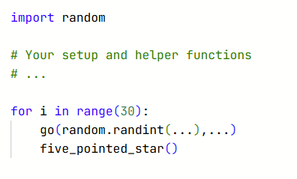
Turtle
Last lesson’s homework: make a bunch of stars (over 20)with random coordinates with x within [-500,500] and y within [-250,250].
You should use a for loop and the random library.
Hint:

Slide 3
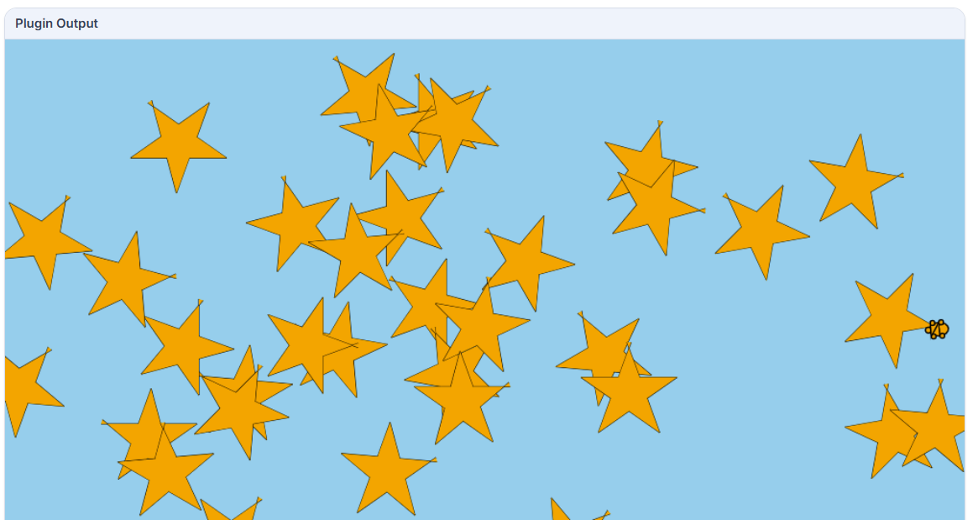
Turtle
Example result for the homework

Slide 4
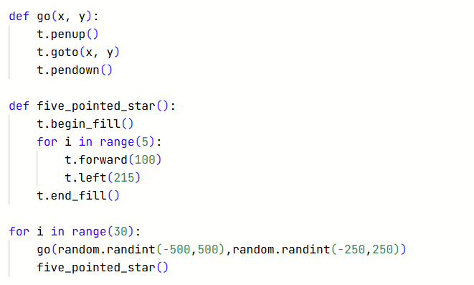
Turtle
Homework answer

Slide 5
Turtle
Exercise: make the star’s sizes randomised

Slide 6
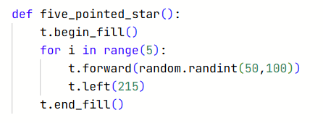
Turtle
Exercise: make the star’s sizes randomised
Does this work?

Slide 7
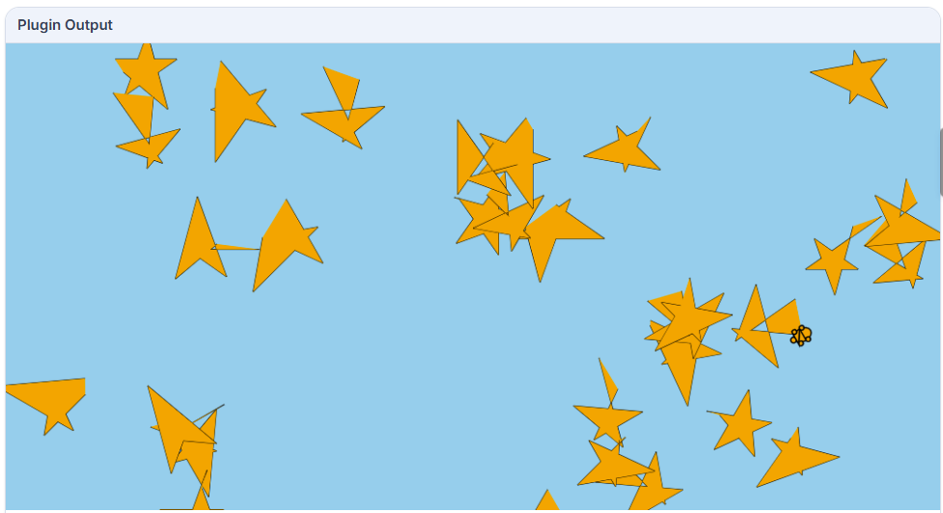
Turtle
Exercise: make the star’s sizes randomised
Does this work?
Oops…

Slide 8
Turtle
Exercise: make the star’s sizes randomised
This doesn’t work because the length of each side is random.
It doesn’t make a star if its five sides have different length

Slide 9
Turtle
Exercise: make the star’s sizes randomised
Let’s define a variable: side length, and randomise it before we draw the star

Slide 10
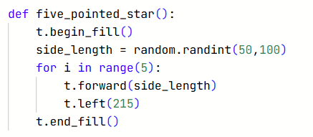
Turtle
Exercise: make the star’s sizes randomised
Then we replace our random value with “side length”

Slide 11
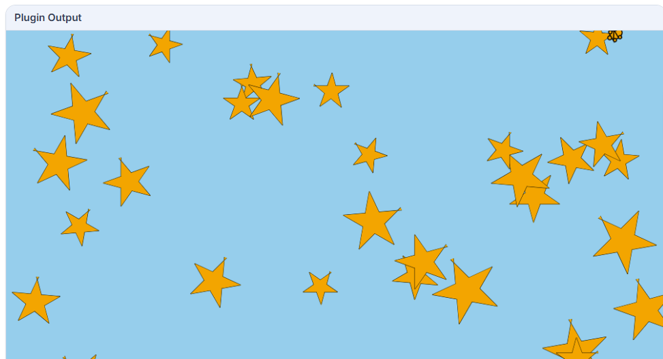
Turtle
The star sizes are randomised now!

Slide 12
Turtle
Exercise: make the stars’ colour chosen from “orange”, “yellow” and “gold” randomly.

Slide 13
Turtle
Exercise: make the stars’ colour chosen from “orange”, “yellow” and “gold” randomly.
Let’s define a colour variable

Slide 14
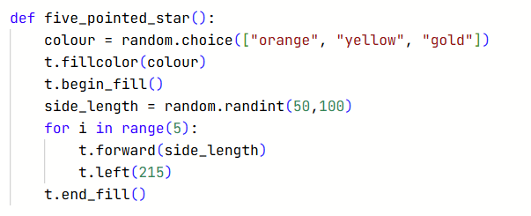
Turtle
Exercise: make the stars’ colour chosen from “orange”, “yellow” and “gold” randomly.
Then we change the fill colour whenever we fill a star.

Slide 15
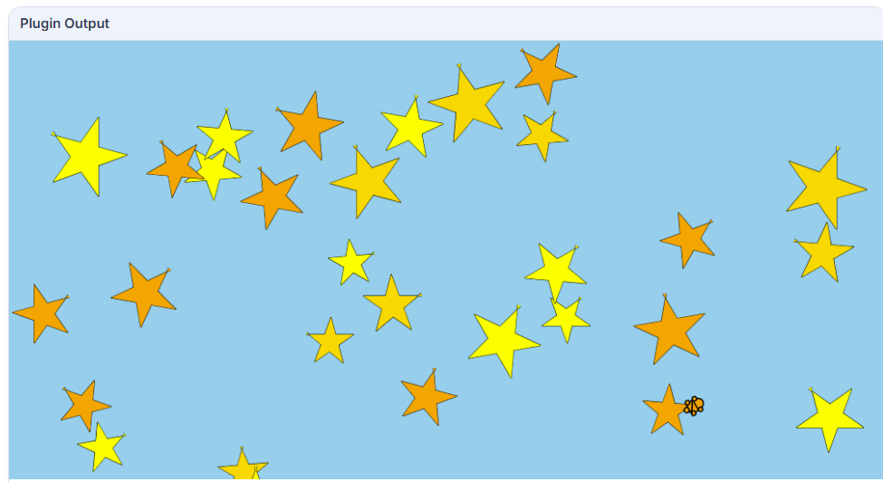
Turtle
We have a bunch more colours now!

Slide 16
Turtle
For the rest of the lesson, let’s work on a project: night sky scenery.

Slide 17
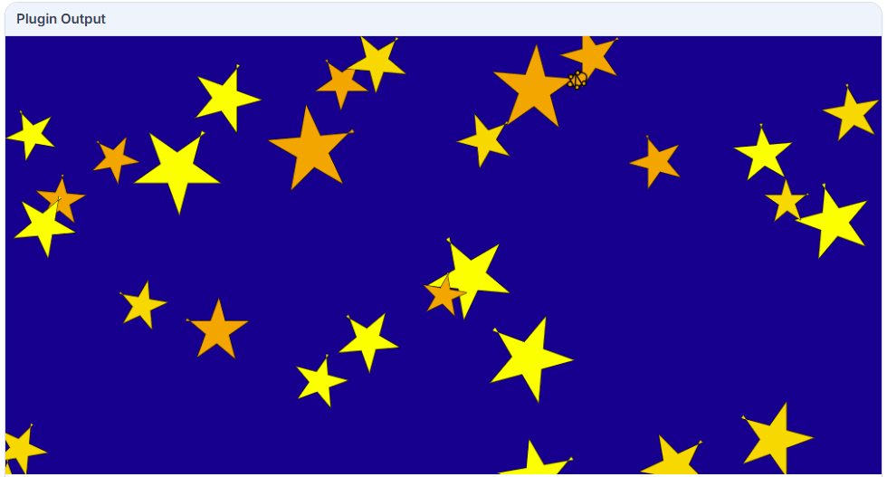
Turtle
Firstly, let’s change our background to

Slide 18
Turtle
Let’s think about what we can add to our canvas.
How about… some clouds?

Slide 19
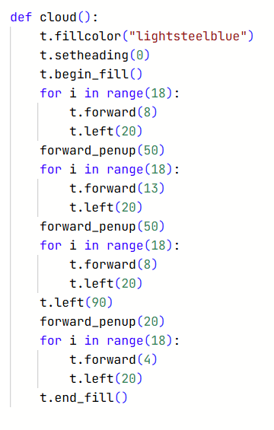
Turtle
This is an example cloud function:

Slide 20
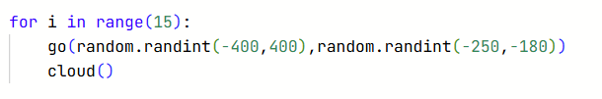
Turtle
Let’s draw the clouds after we draw the stars

Slide 21
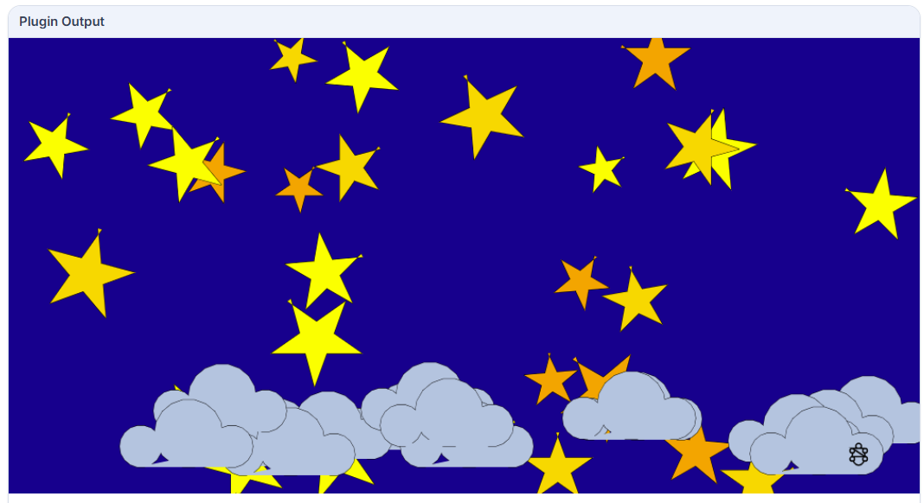
Turtle
Now let’s add the final piece: a crescent moon

Slide 22
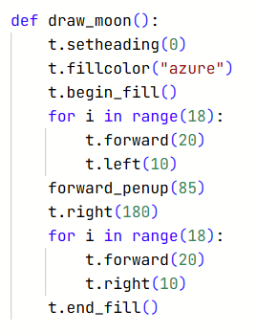
Turtle
Now let’s add the final piece: a crescent moon

Slide 23

Turtle
We add this in the end to draw one crescent moon

Slide 24
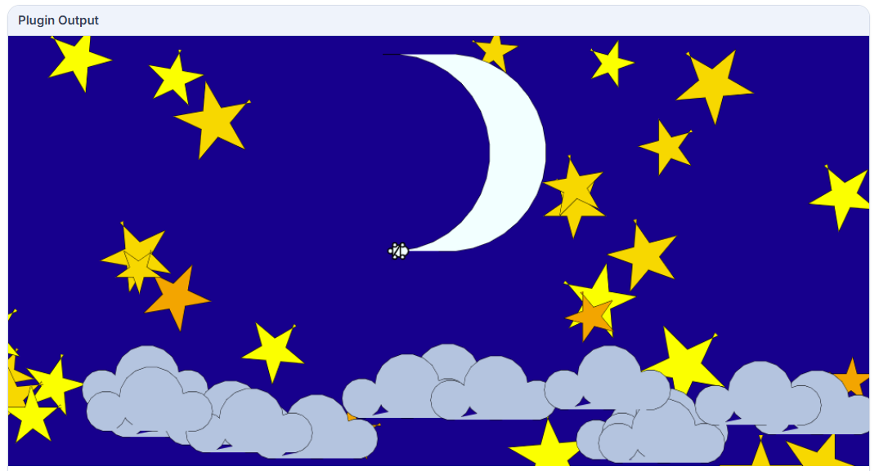
Turtle
Our final project

